Slide 1

Artificial Intelligence and Machine Learning
Density - Based Clustering(DBSCAN) algorithm
Submitted By :
Siddharth .P. Kanikdale – 110 – T214027

Slide 2
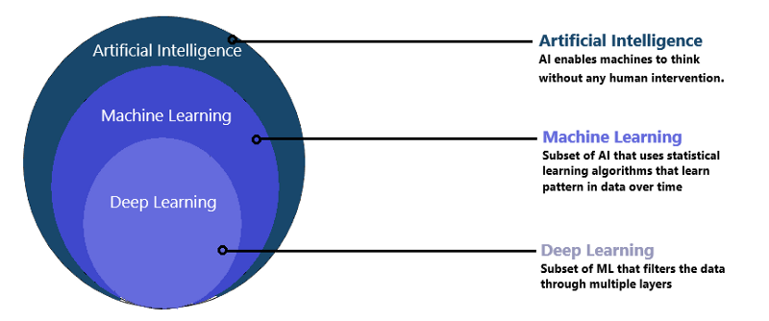
What is Machine Learning?
Machine learning is a branch of artificial intelligence which focuses on designing a machine that learns and makes predictions on the basis of prior knowledge that is “statistical data” in case of machine.

Slide 3
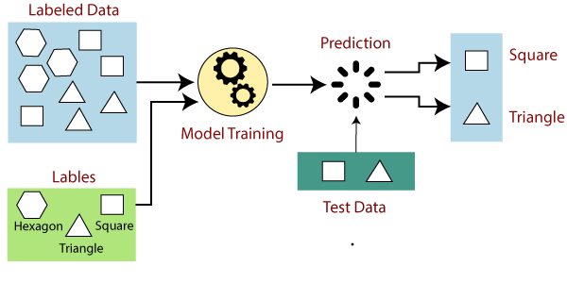
What are the types of ML?
There are two types of Machine Learning
Supervised Learning models
It is a type of machine learning where machine is trained using “labeled” data(i.e. the machine is provided with input as well as output).

Slide 4
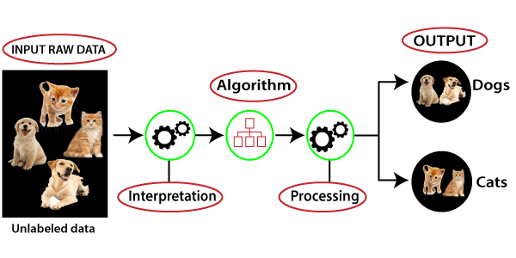
What are the types of ML?
There are two types of Machine Learning
Unsupervised Learning models
It is a type of machine learning where machine is trained using “unlabeled” data(i.e. the machine is provided with only the input and not the target value).

Slide 5
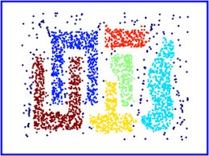
What is Density Based Clustering?
Density based algorithm is also known as DBSCAN(Density-Based Spatial Clustering of applications with noise). It is an unsupervised clustering algorithm utilized for separating high density clusters from low density clusters. It divides the data points into different groups so that the points in the same group have same property.

Slide 6
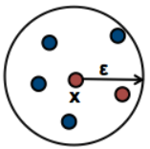
Important point for DBSCAN algorithm?
Epsilon(eps) : It defines a neighborhood around a point(i.e. if the distance between two points is lower or equal to ‘eps’ then they are considered as neighbours). Number of clusters differ on the basis of the epsilon value. The number of noise points may also increase with decreasing epsilon value.

Slide 7
Important point for DBSCAN algorithm?
Minimum Points(min_samples): The minimum points decide the type of the data point.
Core Point : If there exists equal or more points than the minimum points inside the radius(epsilon), then the data point is considered as a core point.
Border Point : If there exist less number of points than the minimum points inside the radius(epsilon), then the data point is called border point.
Noise Point : If there exist no point within the radius of the point then it belongs to the noisy point group.

Slide 8
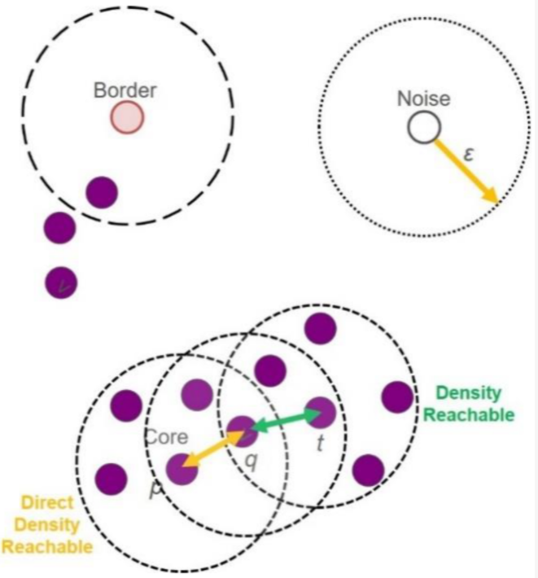
Important point for DBSCAN algorithm?

Slide 9
Why use DBSCAN?
The clusters formed using K-means or hierarchical are mostly spherical or convex shaped whereas in DBSCAN the clusters can be of any size just the properties should be same.
K-means or hierarchical clustering algorithms does not work well for noisy points whereas DBSCAN is meant for working with noisy points.
K-means is not efficient with large dataset and DBSCAN can work efficiently with larger data points.

Slide 10
Thank You!!

